Slide 1
COMPLEX NUMBERS

Slide 2
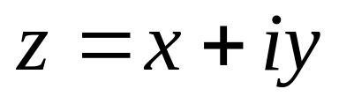
Definition:
A complex number is a number of the form
where: x = real part
iy = imaginary part
This is called the rectangular form.
Examples: 1. z = 2 + 3i 3. z = -5 – 6i
2. 3i 4. z = -5 + i

Slide 3
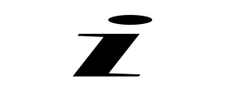

Integral Powers of
From
Find the values of:
i² f. i³⁷⁵⁶
i³ g. i¹⁴²⁷⁵
i⁴ h. i²⁰⁵³ + 3i¹²⁵⁰
i⁵
i⁶

Slide 4
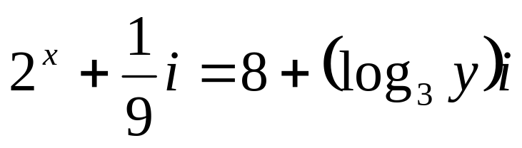
Equality of Two Complex Numbers
Let z₁ = x + iy and z₂ = u + iv
Then, z₁ = z₂ if x = u and y = v
Solve for x and y
1. (x + yi)i + 2 = 3x + y – 4i
2.

Slide 5

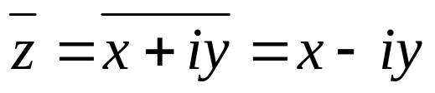
Complex Conjugate
The conjugate of a complex number z = x + iy, denoted by is defined as .
Examples: Find the complex conjugate of each
3 + 4i
2 – 5i
-6 – i
3i

Slide 6
Operations on Complex Numbers
Let z₁ = x + iy and z₂ = u + iv
Addition
z₁ + z₂ = (x + iy) + (u + iv)
z₁ + z₂ = (x + u) + (y + v) i
Subtraction
z₁ - z₂ = (x + iy) - (u + iv)
z₁ - z₂ = (x - u) + (y - v) i

Slide 7
Operations on Complex Numbers
Multiplication
z₁ z₂ = (x + iy)(u + iv)
= xu + (xv + yv)i + yvi²
= xu + (xv + yv)i + yv(-1)
= (xu – yv) + (xv + yv)i

Slide 8
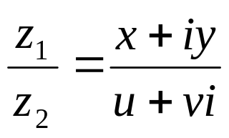
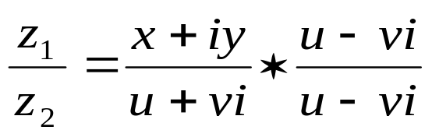
Operations on Complex Numbers
Division
To divide a number by a complex number, multiply both the numerator and denominator by the conjugate of the denominator.

Slide 9

Operations on Complex Numbers
Examples: Perform the indicated operation
If z₁ = 5 + 3i, z₂ = 2 – 7i, z₃ = -5i,
find: z₁ + z₂ + z₃, z₁z₃ - z₂
Find the value of (2 + i)²(2 – i)²
Find the value of 5i¹⁰ - 7i⁸ + 9i⁵
Evaluate

Slide 10

Polar Form of a Complex Number
From x = r cos θ and y = r sin θ
and z = x + iy (rectangular form)
Therefore z = r cos θ + i r sin θ
z = r (cos θ + i sin θ) (polar form)
This may also be written as rcis θ or r θ.
where r = modulus or absolute value
θ = argument (in degrees or radians)

Slide 11


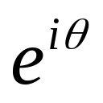
Exponential Form of the Complex Number
From Euler’s Equations:
And z = r (cos θ + i sin θ) (polar form)
Thus, z = r (exponential form)
where : θ is in radians

Slide 12
Examples:
Express the following complex numbers in polar and exponential forms.
z₁ = 3 + 5i
z₂ = -6 + 3i
z₃ = 5i
z₄ = 2 – 5i

Slide 13
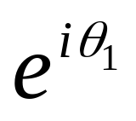
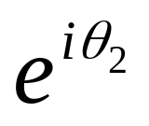
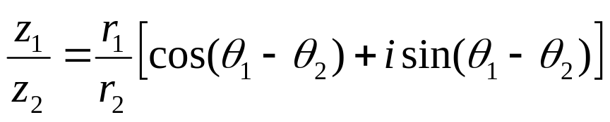
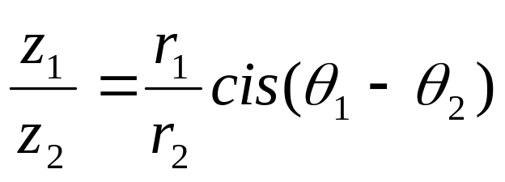
Product and Quotients in Polar Form
Let z₁ = r and z₂ =r
Products of Complex Numbers in Polar Form
z₁z₂ = r₁r₂[cos (θ₁ + θ₂) + i sin (θ₁ + θ₂)]
or z₁z₂ = r₁r₂ cis (θ₁ + θ₂)
Quotient of Complex Numbers in Polar Form
or

Slide 14
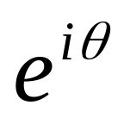
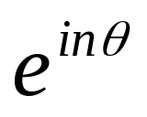
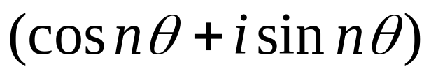
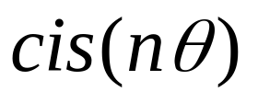
Powers of Complex Number
Let z = r
zⁿ = rⁿ (exponential form)
zⁿ = rⁿ (polar form)
or zⁿ = rⁿ

Slide 15

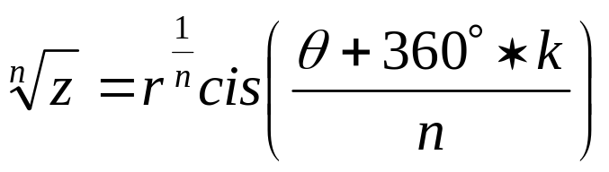
Roots of Complex Number
Let z = r
The general exponential form is
And the general polar form is
where k is any integer
Thus

Slide 16
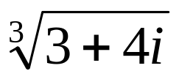

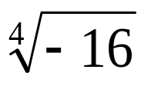
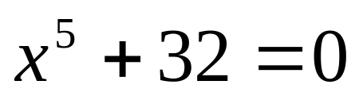
Examples:
Find the values of the following:
(3 + 4i)⁵
Solve for x:

Slide 17
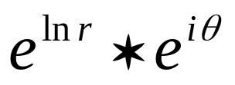
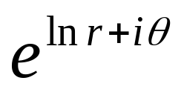
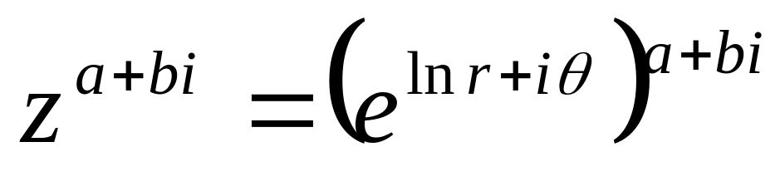
Complex Powers
Let z = r
=
=

Slide 18
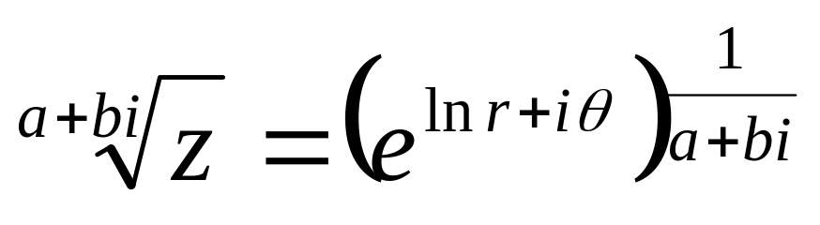
Complex Roots
Let z = r
=
=

Slide 19
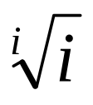
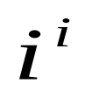

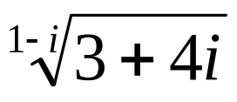
Examples:
Find the values of the following:
1.
2.
3.
4.

Slide 20
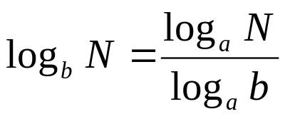
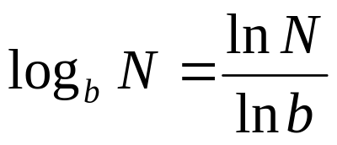
Logarithms of Complex Numbers
From z = r
Applying ln on both sides,
ln z = ln r
ln z = ln r + iθ ln e but ln e = 1
ln z = ln r + iθ (principal value)
ln z = ln r + i(θ + 2π k) (general value)
Note: Change of Base Formula
where b = any base > 0 and a = base 10

Slide 21


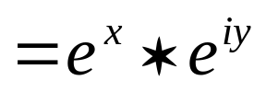
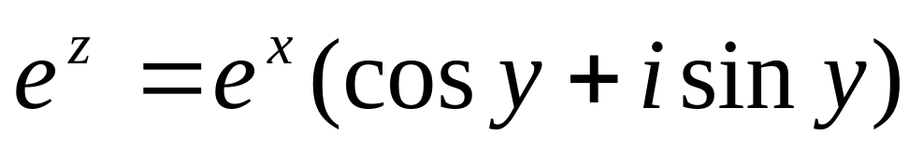
Exponential Function of the Complex Number
Use:
Thus:
where y is in radians

Slide 22
Trigonometric Functions of the Complex Number
sin z = sin (x ± iy) = sin x cos iy ± cos x sin iy
cos z = cos (x + iy) = cos x cos iy – sin x sin iy
cos z = cos (x – iy) = cos x cos iy + sinx sin iy
Hyperbolic Functions of the Complex Numbers
sinh z = sin (x±iy) = sin x cos iy ± cos x sin iy
cosh z = cosh (x ±iy) = cosh x coshiy ± sinh x sinh iy
Relationship between Trigonometric and Hyperbolic Functions
sin iy = isinh y
sinh iy = isin y
cos iy = cosh y
cosh iy = cosh y

Slide 23
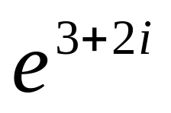
Examples:
Find the values of the following:
General value of ln (3 + 4i)
Principal value of log (3 + 4i)
sin 2i
cos (3 + 2i)
cosh (3 + 2i)

Slide 24
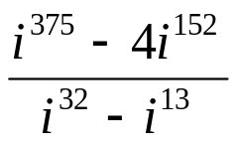
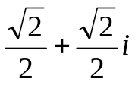
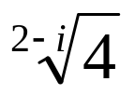
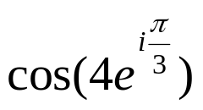
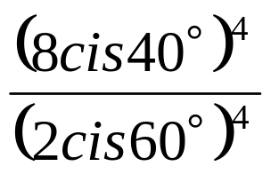

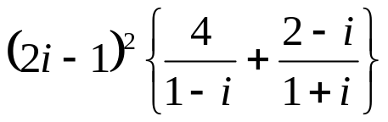
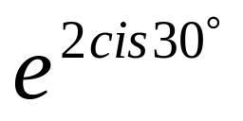

Homework # 4
1. Find the following:
Cube roots of f.
ln (1 + i) g.
[(1 + i)(3 + 4i)]⁴ h.
i.
j.
If z₁ = 2 – 2i, z₂ = -4-3i, and z₃ = -1 +i, evaluate:
a. z₁z₂² b. z₁/z₂ c.

